Slide 1
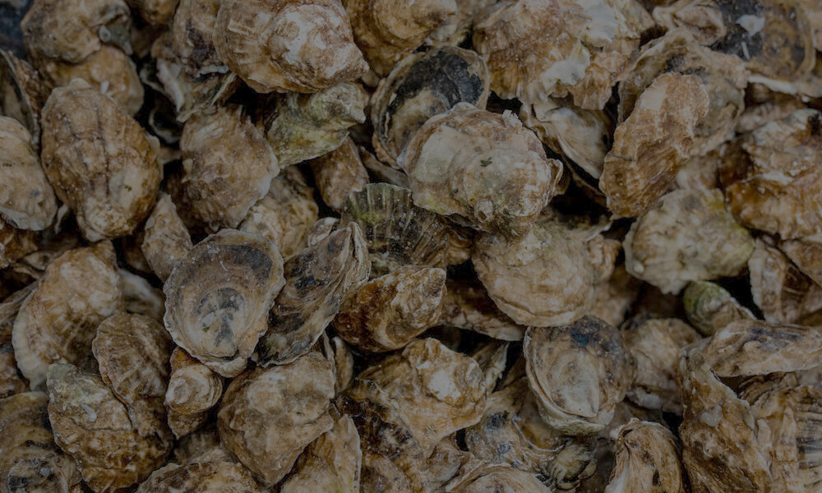
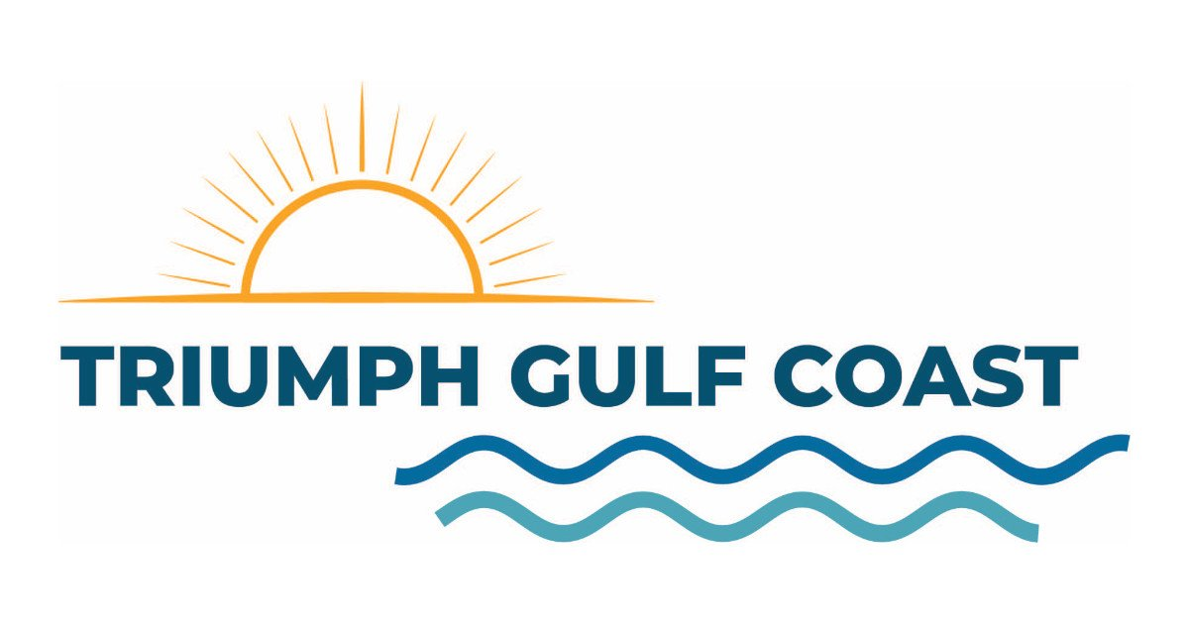
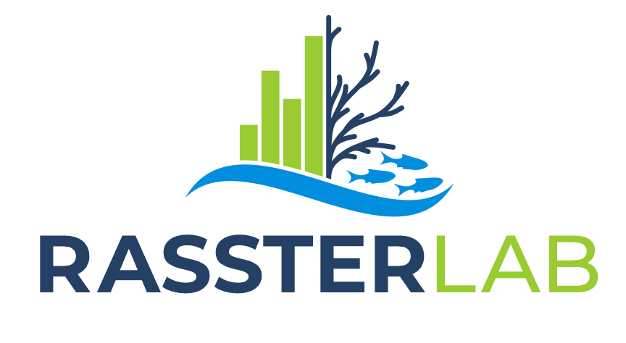
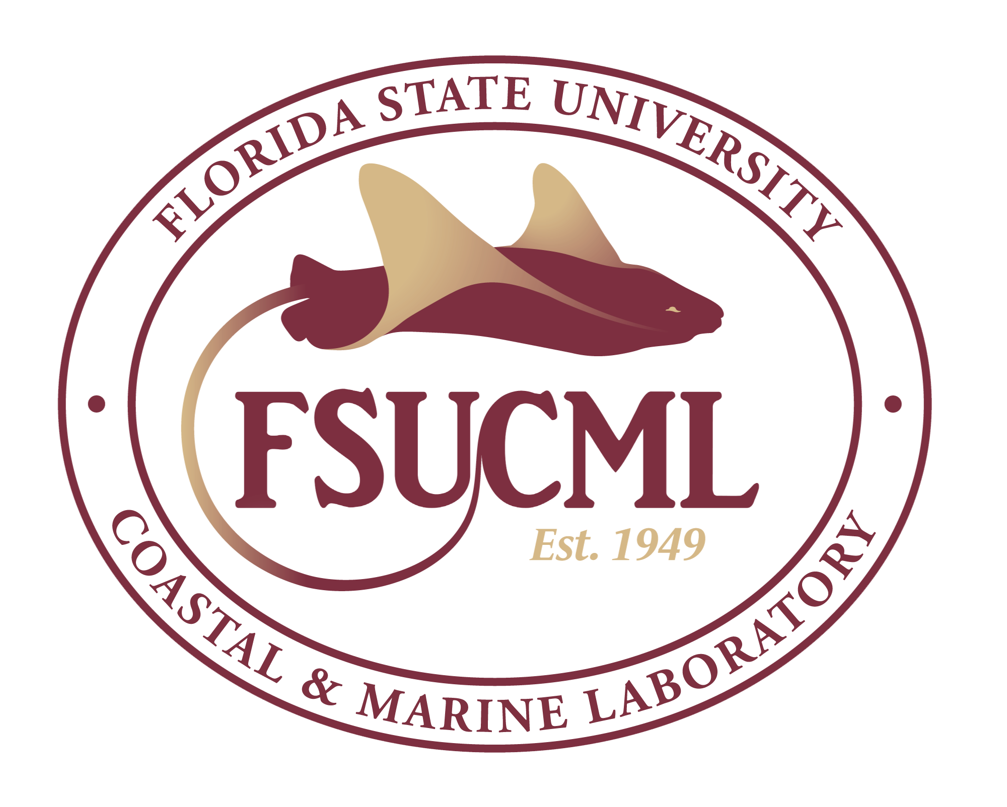
Defining oyster restoration success: Current approaches, targets and priorities of Florida’s Gulf Coast
Dr. Betsy Mansfield
Florida State University – Coastal & Marine Lab
emansfield@fsu.edu

Slide 2
Defining goals for restoration
Recent shift in restoration goals from fisheries enhancement to holistic ecosystem function recovery (Baggett et al. 2015)
Thresholds or endpoints provide targets to meet recovery goals (Dey & Schweitzer 2014)
What if the goals of a restoration project misalign with the goals and expectations of stakeholders within the resource system?
Notes:
Goal mismatch can lead to unmet expectations

Slide 3
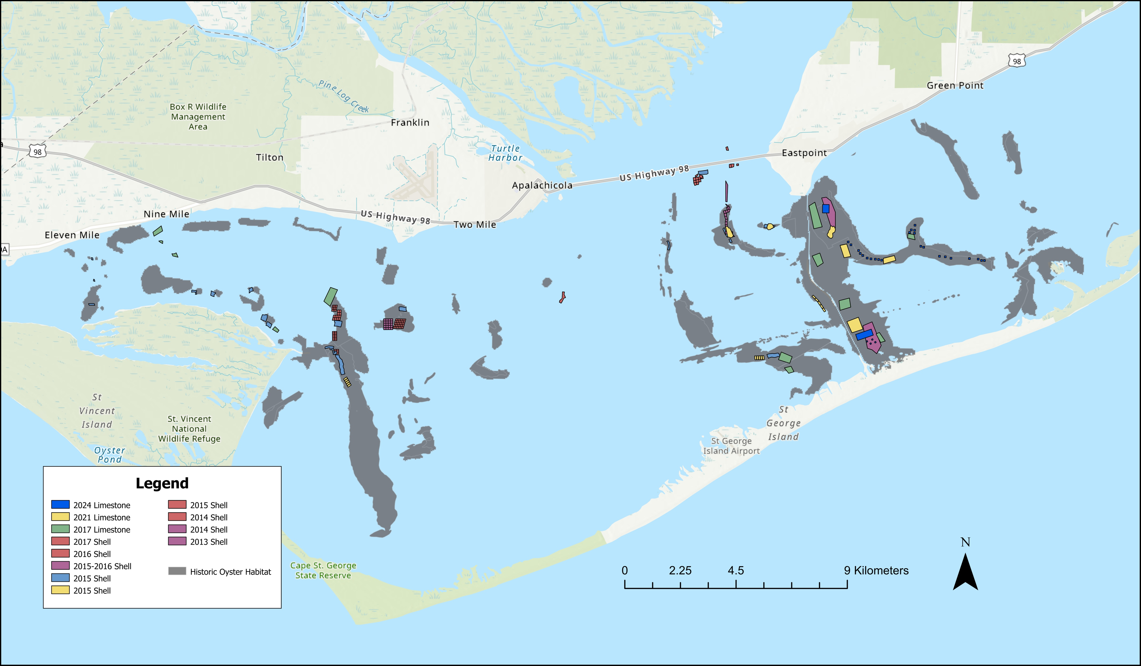
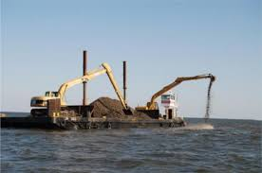
Apalachicola Bay oyster restoration
1949
State shelling program est.
1870s
Oysters become the primary industry
2013-2021
Various shell and limestone planting
2019
NFWF funding for large scale restoration
2020
5 year commercial harvest closure
2024
FWC Major restoration effort (NFWF)
2011
Shelling program ends
Notes:
Apalachicola Bay has harvested oysters commercially since the 1800s, once providing 90% of all oysters harvesting in florida, and employing over 700 people in harvesting just alone. This does not include the employment brought from seafood processing, selling, boat building, and other related professions
However recent years have seen steep declines in populations, and even a five year fishery closure, that only just opened back up.
With the number of services the oyster provides within the bay, the loss of the species may have far greater impacts than previously considered by ecologists or economists (when thinking about fishery species), and understanding their loss from both ecological and social dimensions can help future resilience planning and management

Slide 4
HOW HAVE RECENT FLORIDA GULF COAST OYSTER RESTORATION EFFORTS PRIORITIZED AS GOALS AND SUCCESS METRICS?
WHAT DO COMMUNITY MEMBERS PRIORITIZE FOR OYSTER RESTORATION, AND HOW DO THEY DEFINE RESTORATION SUCCESS?

Slide 5
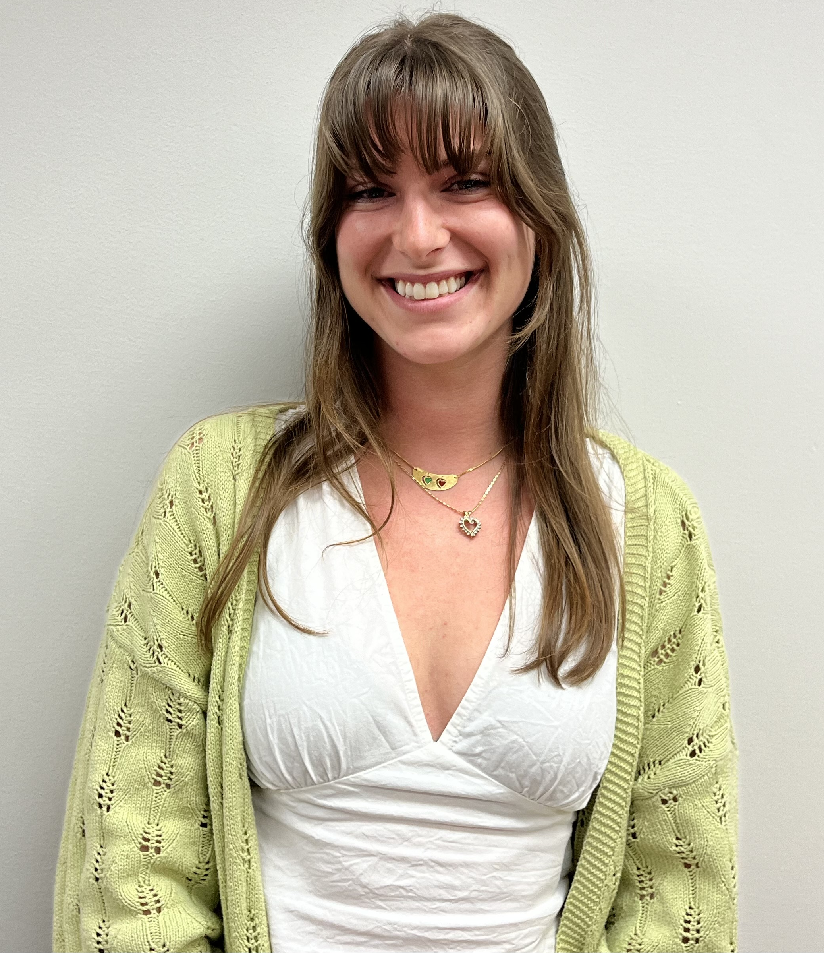
Florida Gulf Coast Restoration Database
Projects located along the Florida Gulf Coast
2000-present
Cases obtained from NOAA Restoration Atlas & ABSI Oyster Restoration Database
34 projects with physical restoration methods included
Holly DeMaria
UROP Student

Slide 6
Florida Gulf Coast Restoration Database
Restoration Goals
Restoration Methods
Did they define success?
Success metrics
Monitoring & Length
Recovery Thresholds
Increase oyster population, habitat enhancement
Spat on shell, adult outplant
Oyster abundance, size distributions, reef size
Defined target densities, vertical relief, spat presence, etc.

Slide 7
Many cases had multiple goals for restoration

Slide 8
Both population and ecosystem services of focus
Percentage of projects defining success as an increase or change in specified metric

Slide 9
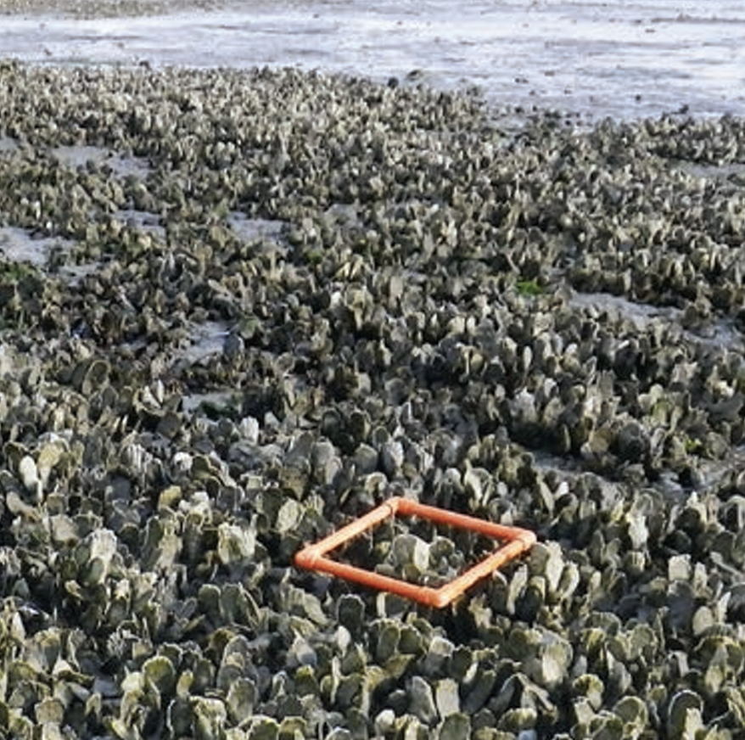
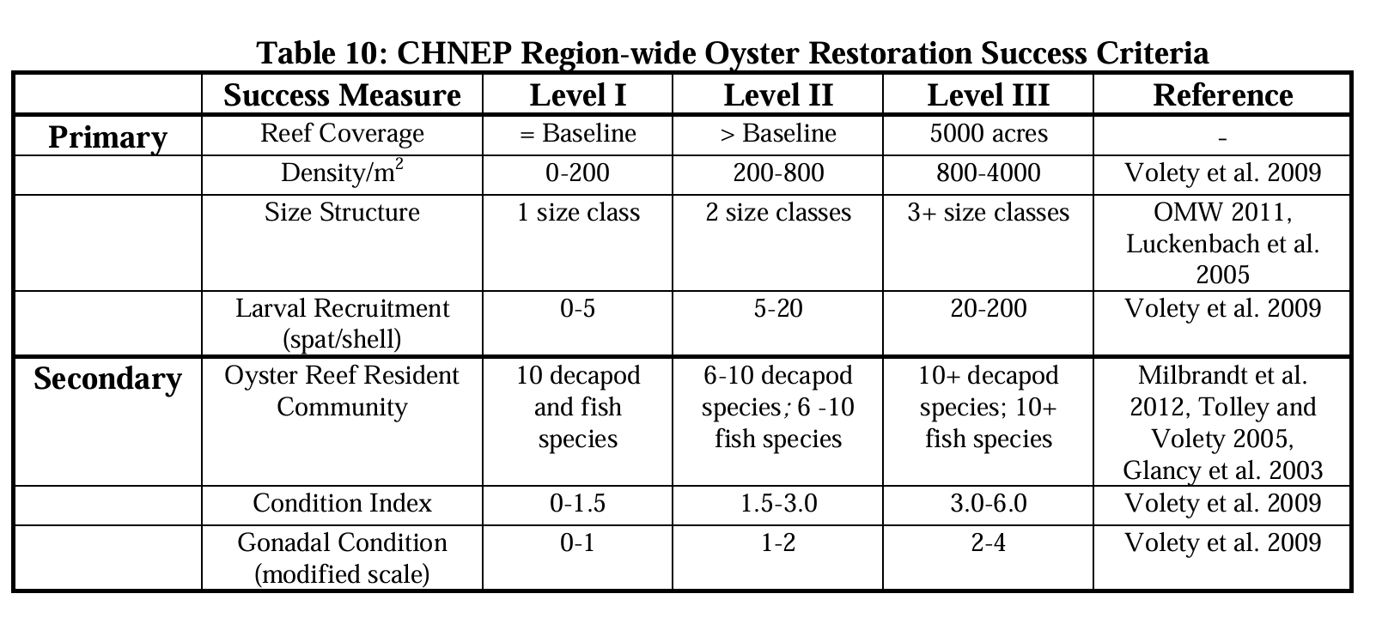
Only 29% of cases defined target metric thresholds
Definitions were often loose and varied
Case #31: “We will create 3.6 acres of fishery habitat”
Case #3: Success would be determined by a level system. Level 1 is 50-100 oysters, level 2 is 100-200, and level 3 is 200+ oysters per defined area.
Notes:
success metric defined as what the project is aiming to see an increase or change in that is quantifiable in some way

Slide 10
Goals are good, but how do we know if we met them?
Baggett et al. 2015 recommend 4 universal reef monitoring metrics: reef area, reef height, oyster density & size-frequency distribution
Additional metrics can be monitored to assess specific goals
Monitoring can evaluate performance, improve subsequent efforts, and inform adaptive management
Notes:
50% of cases referenced monitoring post-restoration, and at very varied rates and lengths of time
Monitoring post-restoration is often the most challenging in terms of securing continuous funding, but is crucial

Slide 11
Defining goals for restoration success
Different goals may require different approaches, and different post-implementation monitoring metrics (Graham et al. 2016, Baggett et al. 2015)
Defining metrics for monitoring can help evaluate performance (Baggett et al. 2015)
Considering priorities of users can help restoring bodies co-develop targets and goals for restoration, manage expectations, and focus messaging and reporting of restoration outcomes

Slide 12
HOW HAVE RECENT FLORIDA GULF COAST OYSTER RESTORATION EFFORTS PRIORITIZED AS GOALS AND SUCCESS METRICS?
WHAT DO COMMUNITY MEMBERS PRIORITIZE FOR OYSTER RESTORATION, AND HOW DO THEY DEFINE RESTORATION SUCCESS?

Slide 13
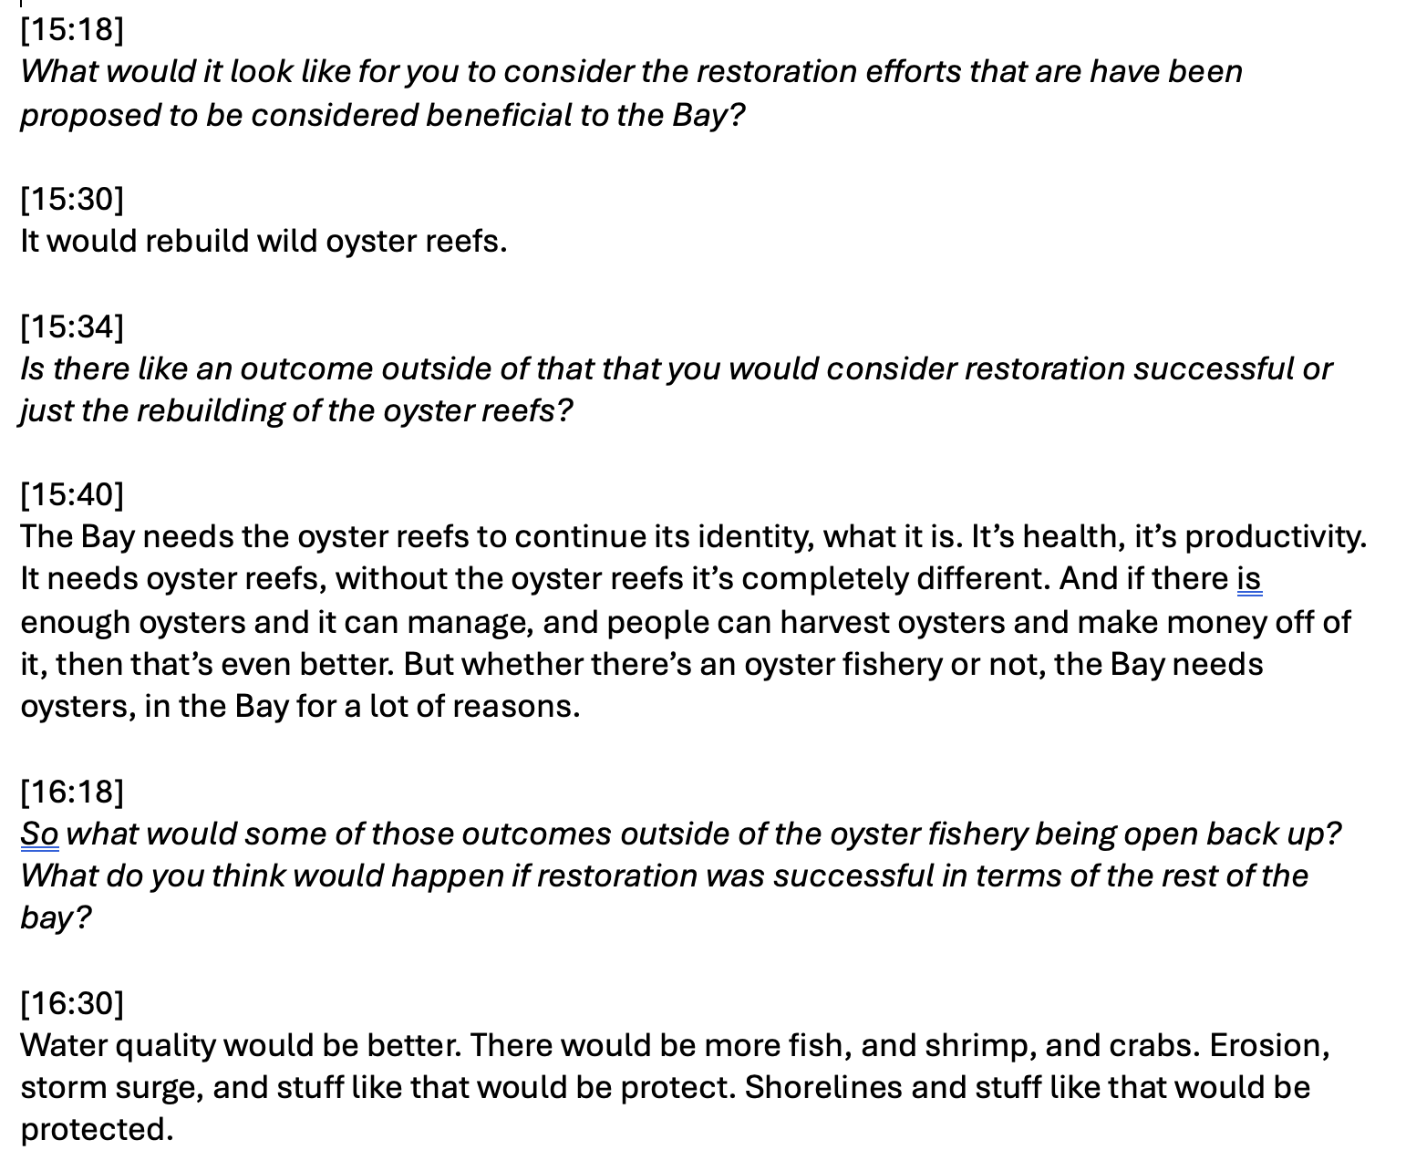

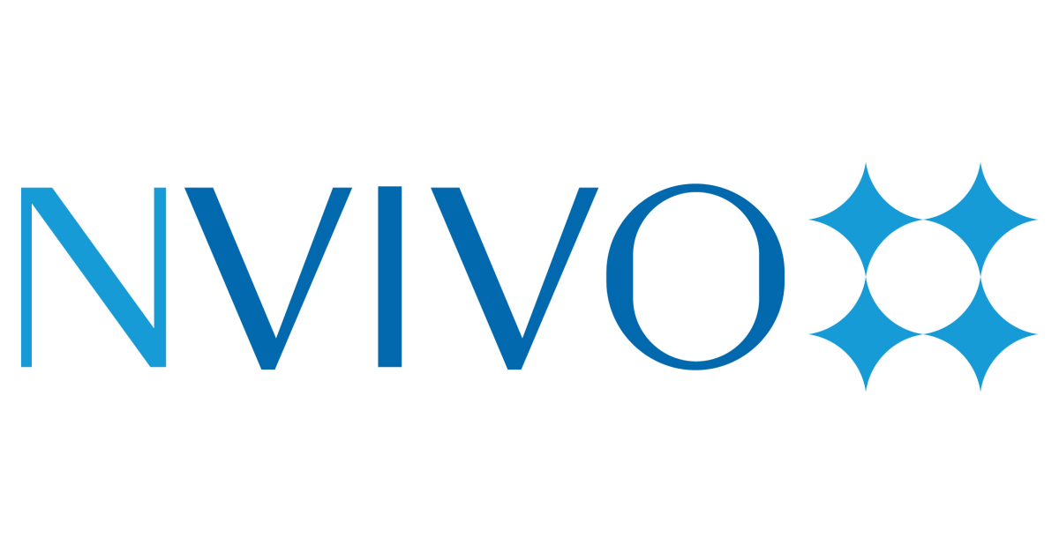
Methods – Interviews with stakeholders
Directed and open-ended questions on the importance of restoration, and participant’s expectations for outcomes from restoration
Interview participants = 26

Slide 14
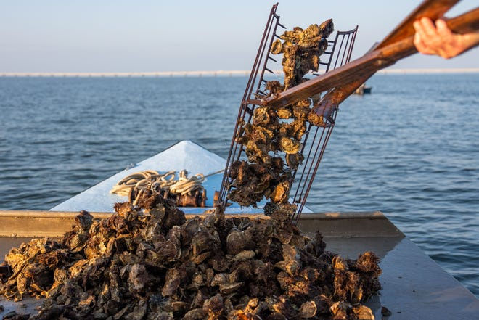
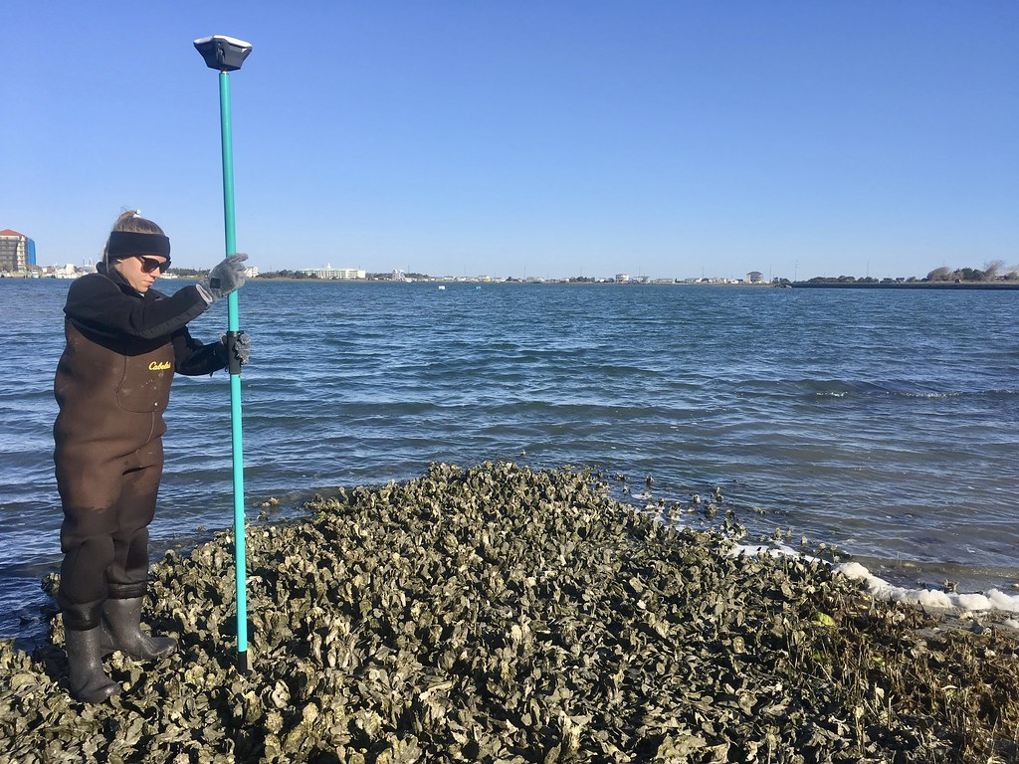
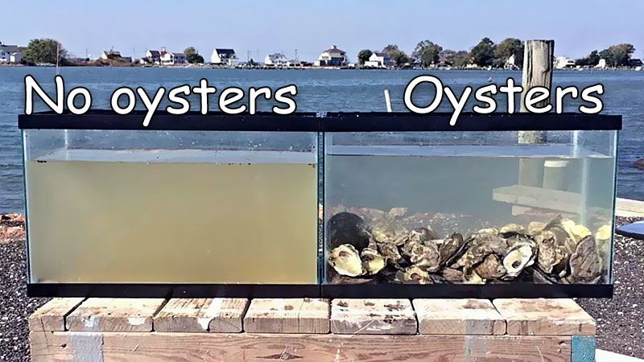
Community success definitions don’t always fit the recommended metrics
Oyster abundance = 17
Reef dimensions = 5
Water quality = 3
No respondents defined success in relation to:
Oyster size distribution
Related habitat responses
Shell budget

Slide 15
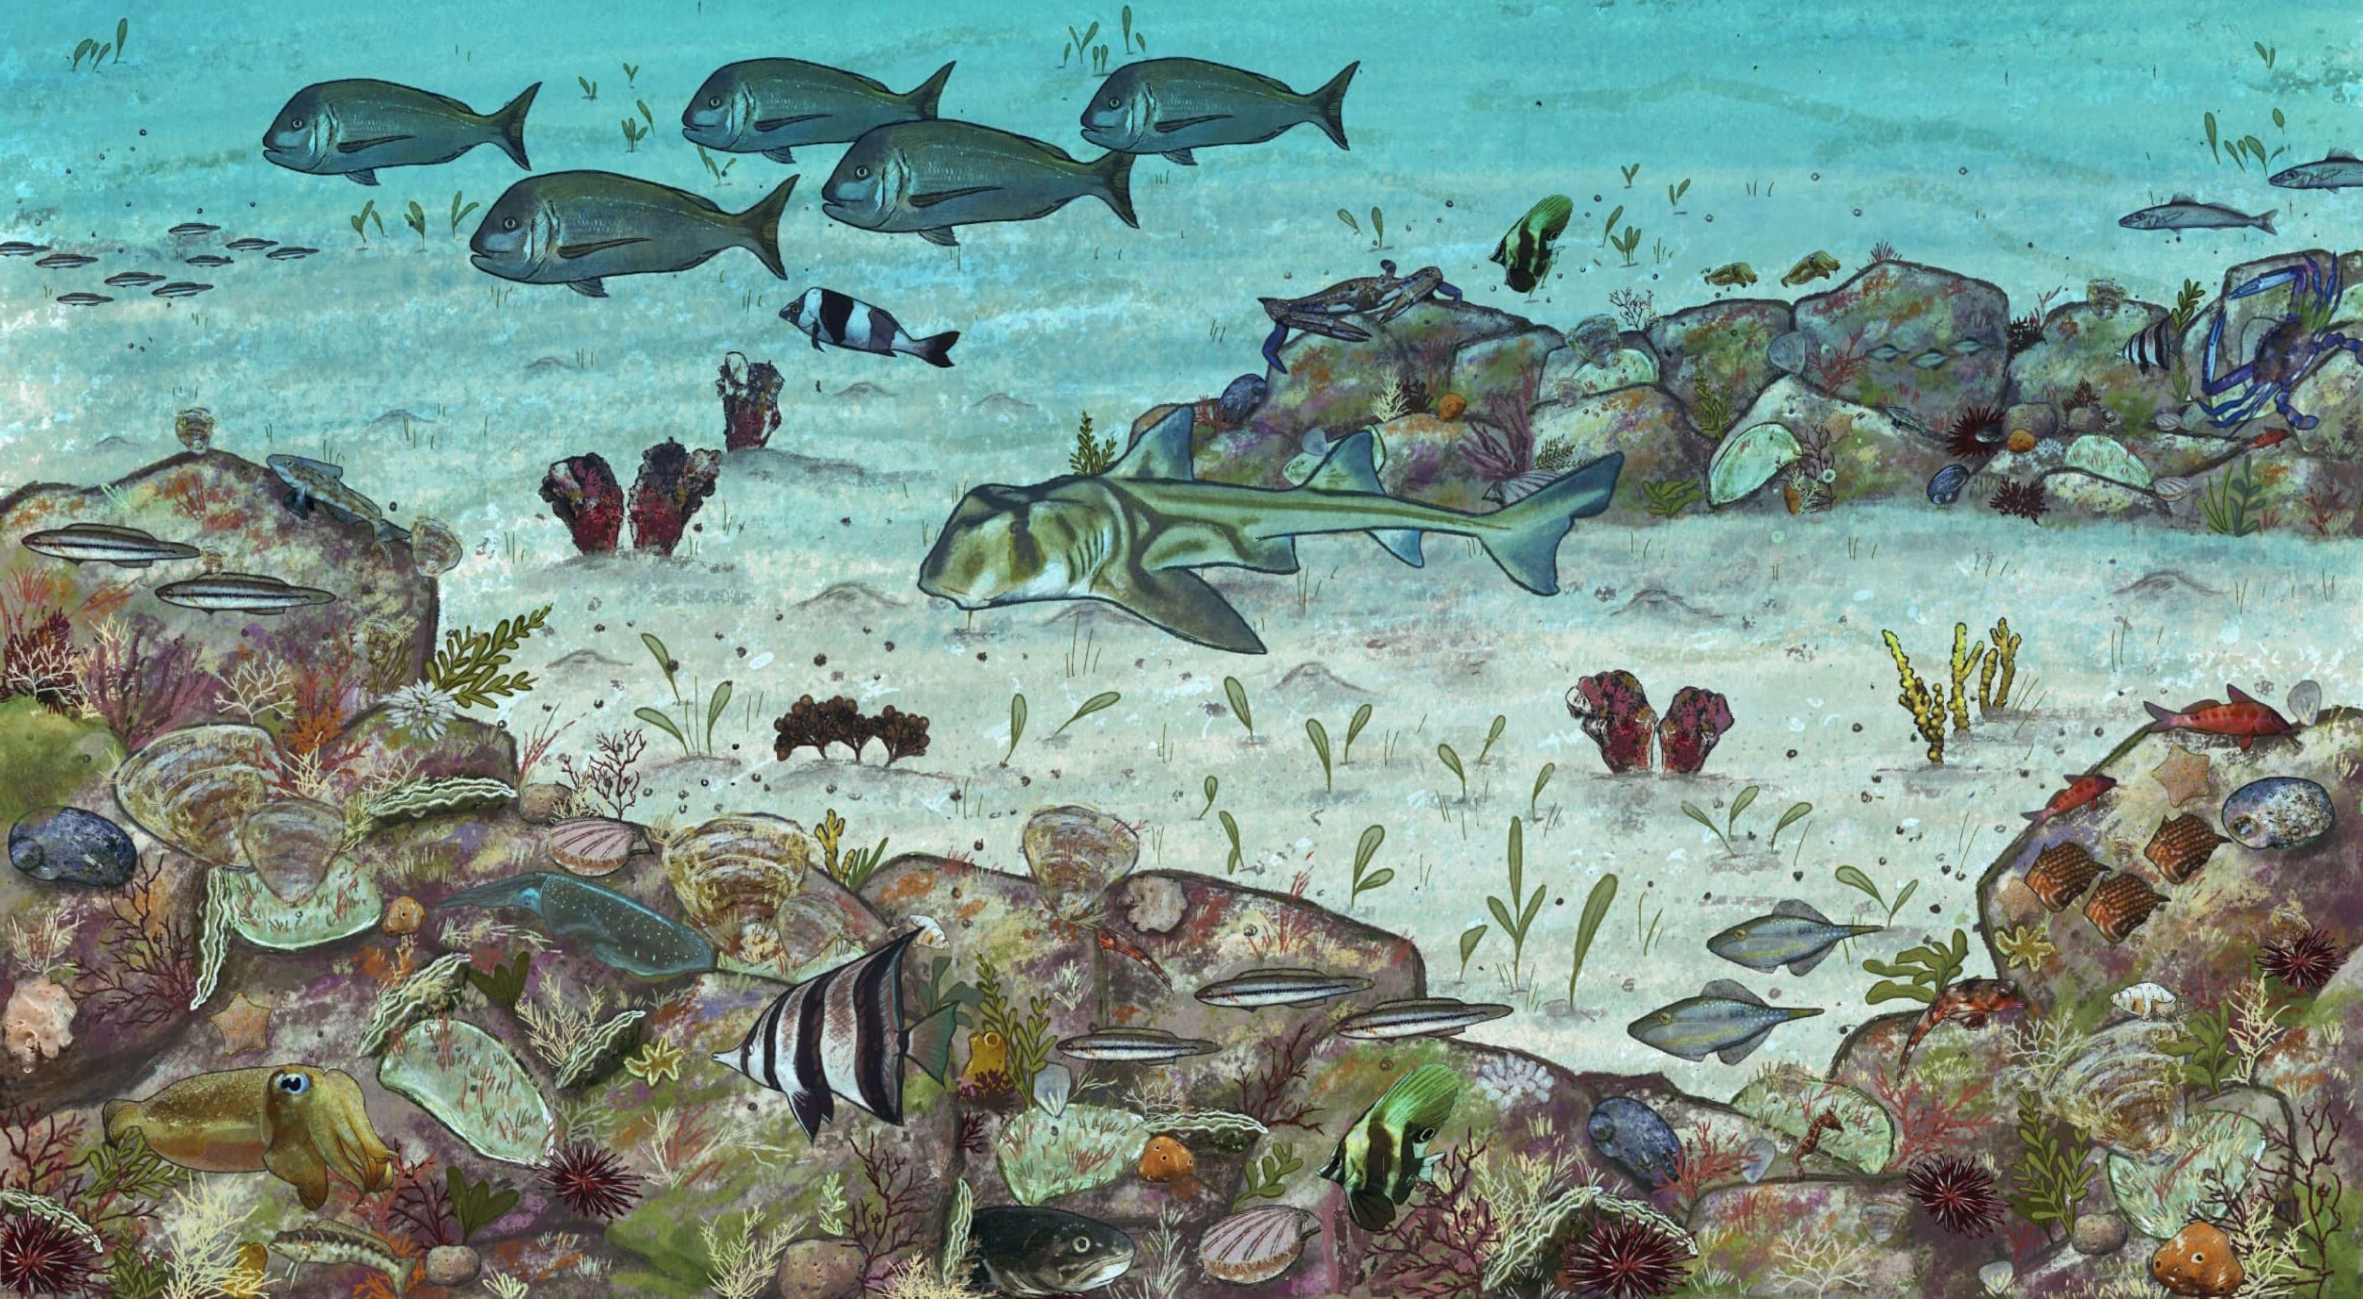
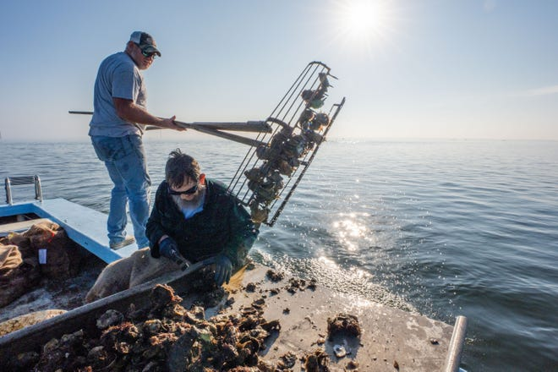
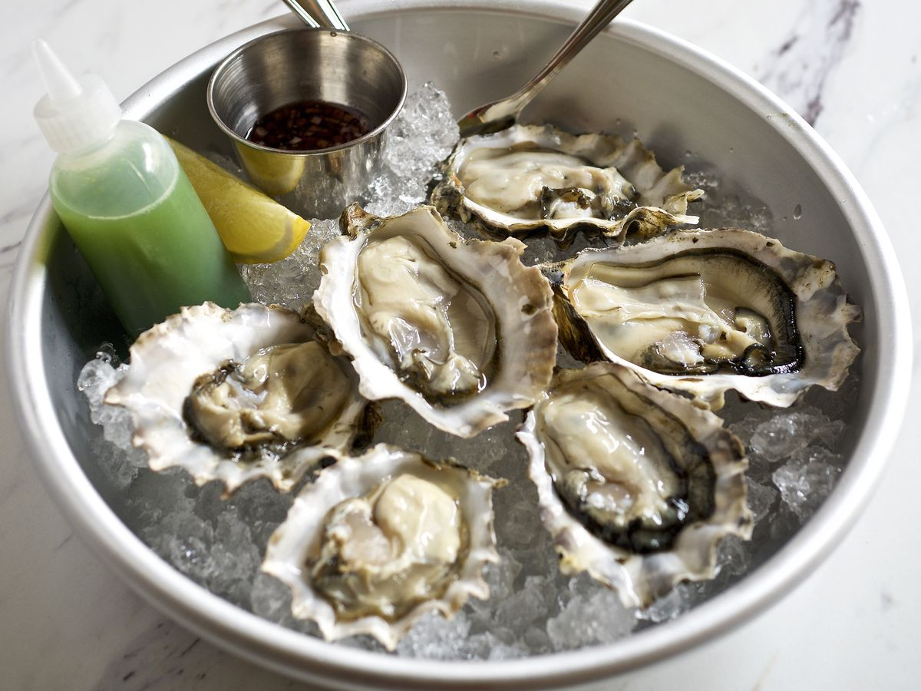
Additional definitions of success encompass ecological and social outcomes
Ecological outcomes
Fishery outcomes
Social outcomes
Non-oyster reef utilization = 5
Shoreline protection = 1
Fishery re-opening = 22
Fishery sustainability = 4
Specified quantity of catch = 9
Access to food = 4
Return of AB Brand = 4
Return of oyster houses and community features = 3
Notes:
* Make clear these are derived and defined from the interviews

Slide 16
“The Bay needs the oyster reefs to continue its identity, what it is. It’s health, it’s productivity. It needs oyster reefs, without the oyster reefs it’s completely different. And if there is enough oysters and it can manage, and people can harvest oysters and make money off of it, then that’s even better. But whether there’s an oyster fishery or not, the Bay needs oysters, in the Bay for a lot of reasons. “
Seafood Dealer
“I'd like to see all the boats back out there working. And then, just I don't know. I'd like to see them all back working. It'd be great. It's a beautiful sight when you go across that bridge in the morning and here's 300 boats over there working. You know, you know the whole economy right here in this area is making some money, you know... I would love to I would love to have boats, you know, come in bring oysters to me and I could turn around sell them like I did.”
Restaurant Owner
“To be successful? Yeah, if you could catch more than two sacks to the boat that would be good.”
Previous Oyster Fisher

Slide 17
Local knowledge can help develop goals, thresholds and baselines
Co-developing goals and endpoints for restoration can help establish success for both ecological and social systems
Defining success thresholds for them long term can provide information on what works and for scaling
Need to monitor focus metrics to understand efficacy
Different restoration goals may need different funding sources x
Notes:
Sometimes stakeholder wants and money wants won’t align – different restoration goals may need different funding sources to meet the different ecological versus social need of a system
Lot of managing bodies want to bring back ecosystem function, but they don’t measure for it – Partnership needs to encourage monitoring folks to actually monitor for these to really understand if restoration is working or not and how

Slide 18

QUESTIONS?
Many Thanks to:
- Interview participants
Dr. Sandra Brooke
Dr. Sarah Lester
Dr. Andrew Rassweiler
Dr. Joel Trexler
Office of Research
The Rasster Lab
emansfield@fsu.edu

Slide 19
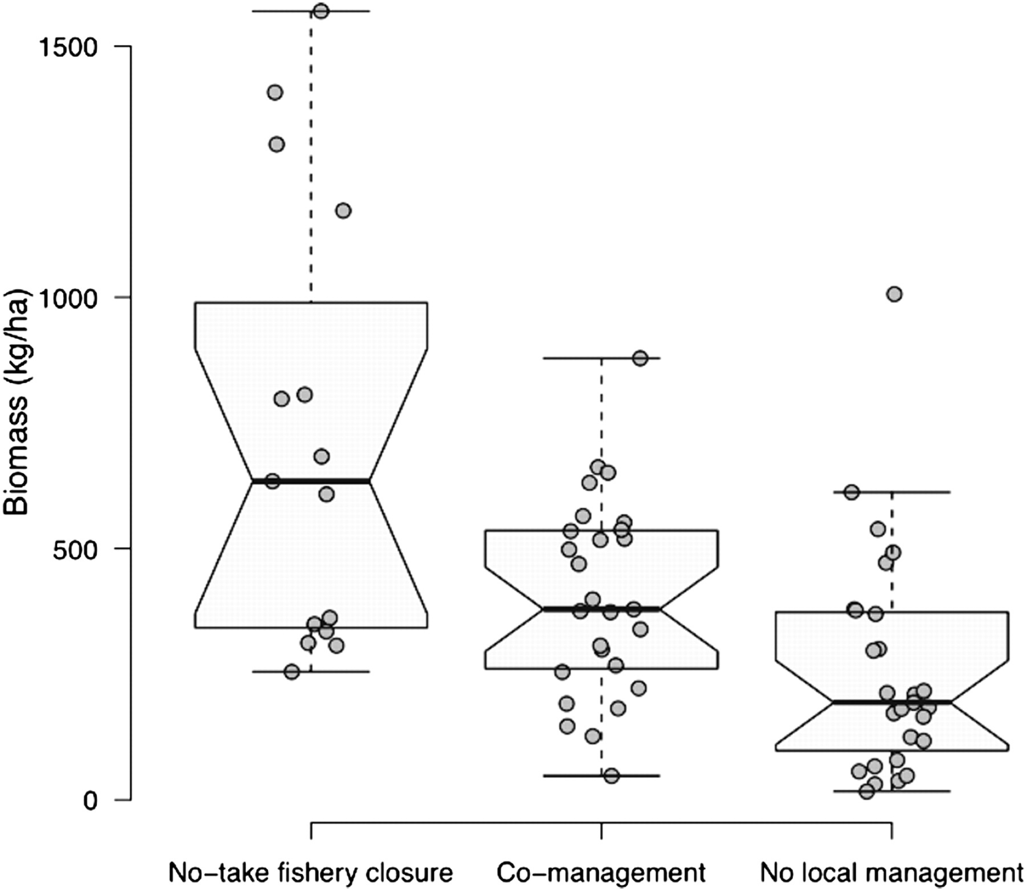
Community buy-in can promote success
Collaboration and
co-management lead to ecologically and economically positive outcomes
Cinner et al. (2012) PNAS

